Slide 1

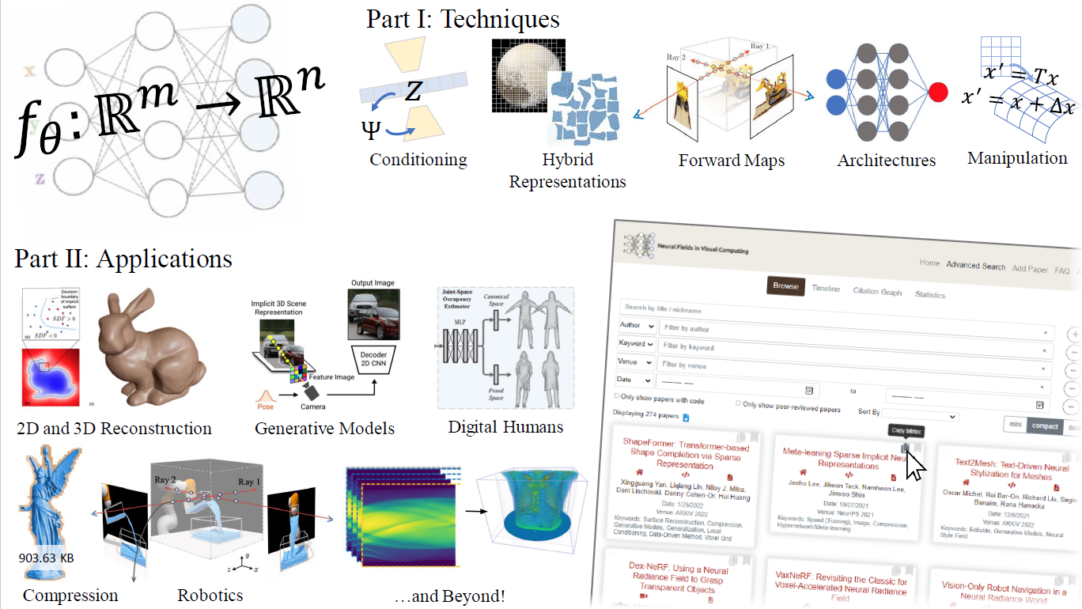
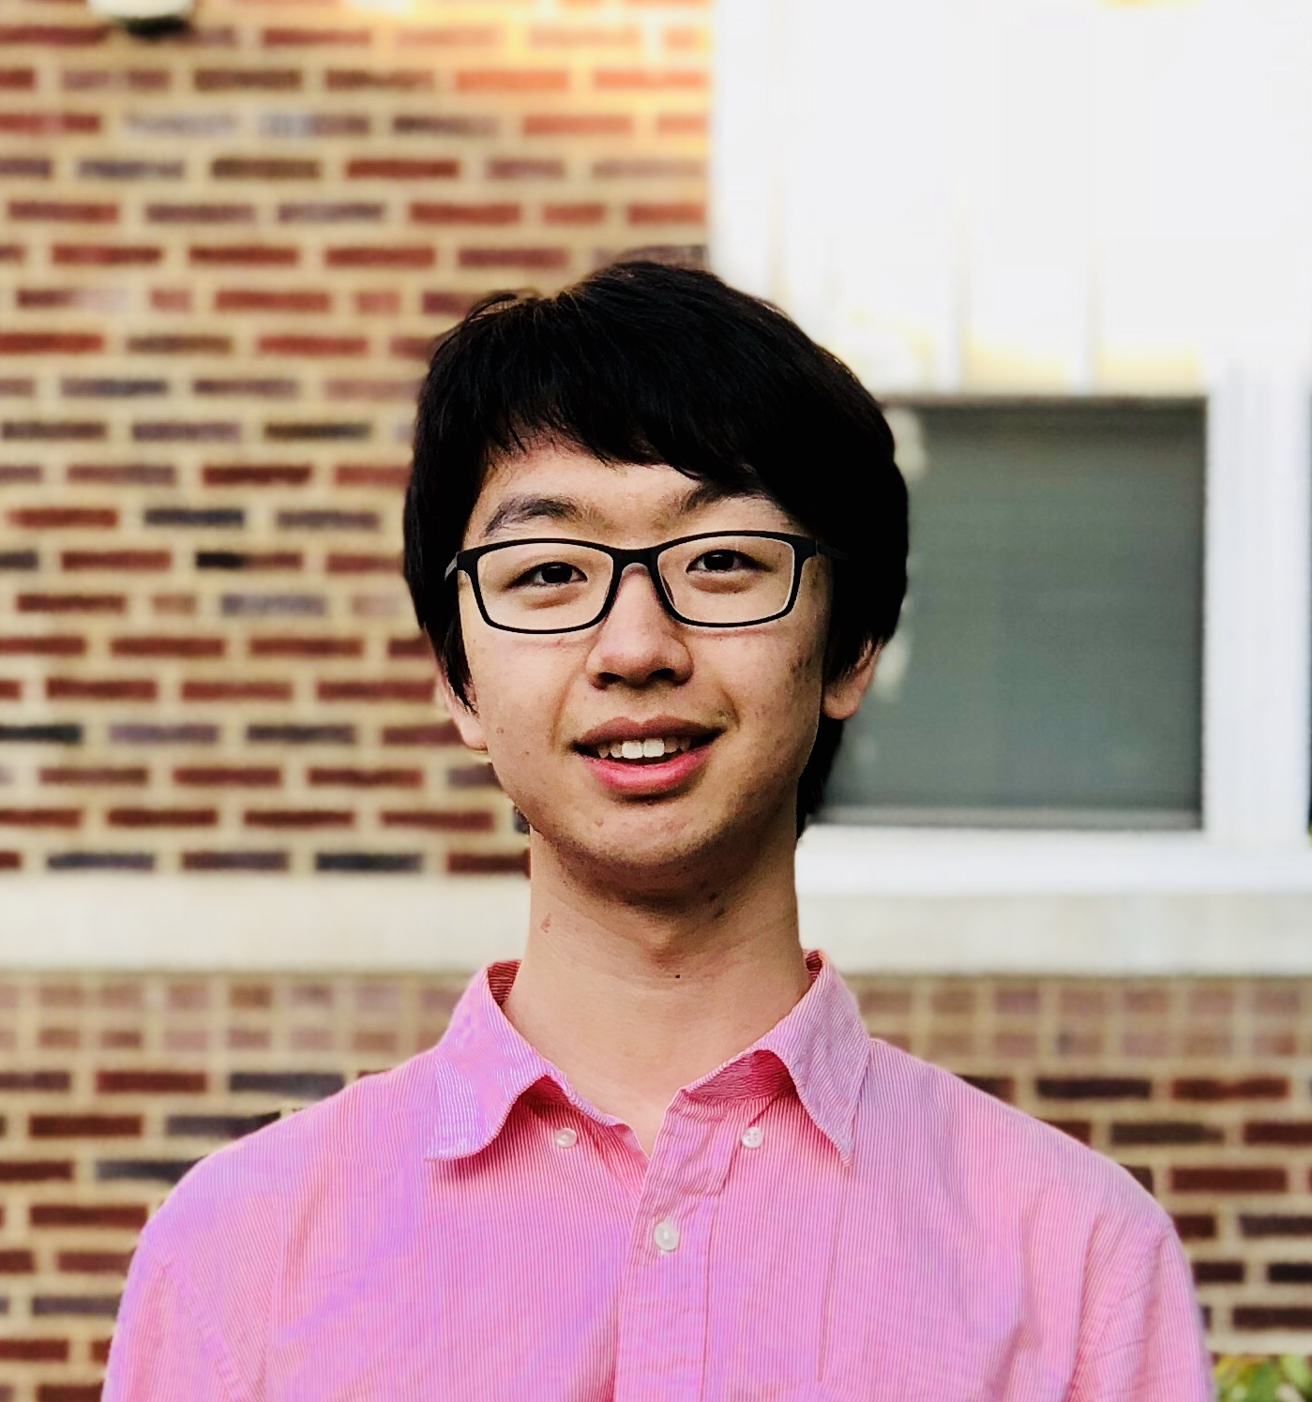
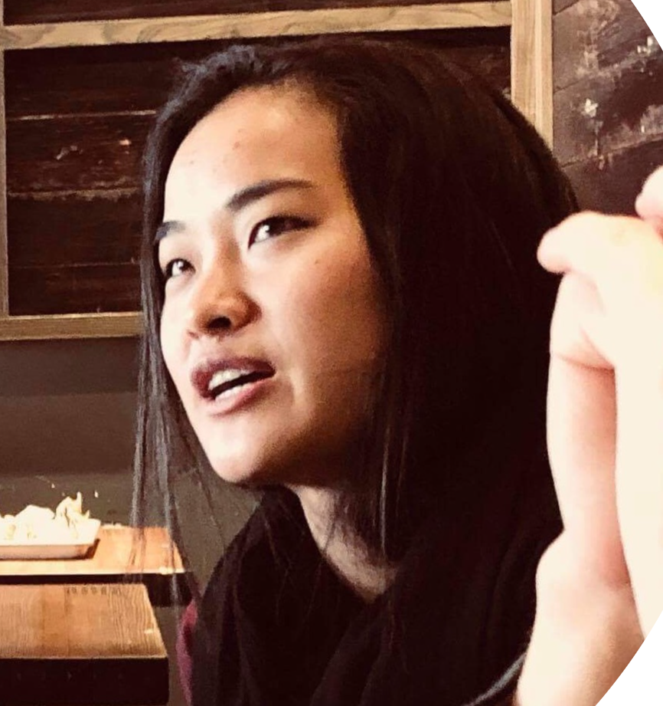
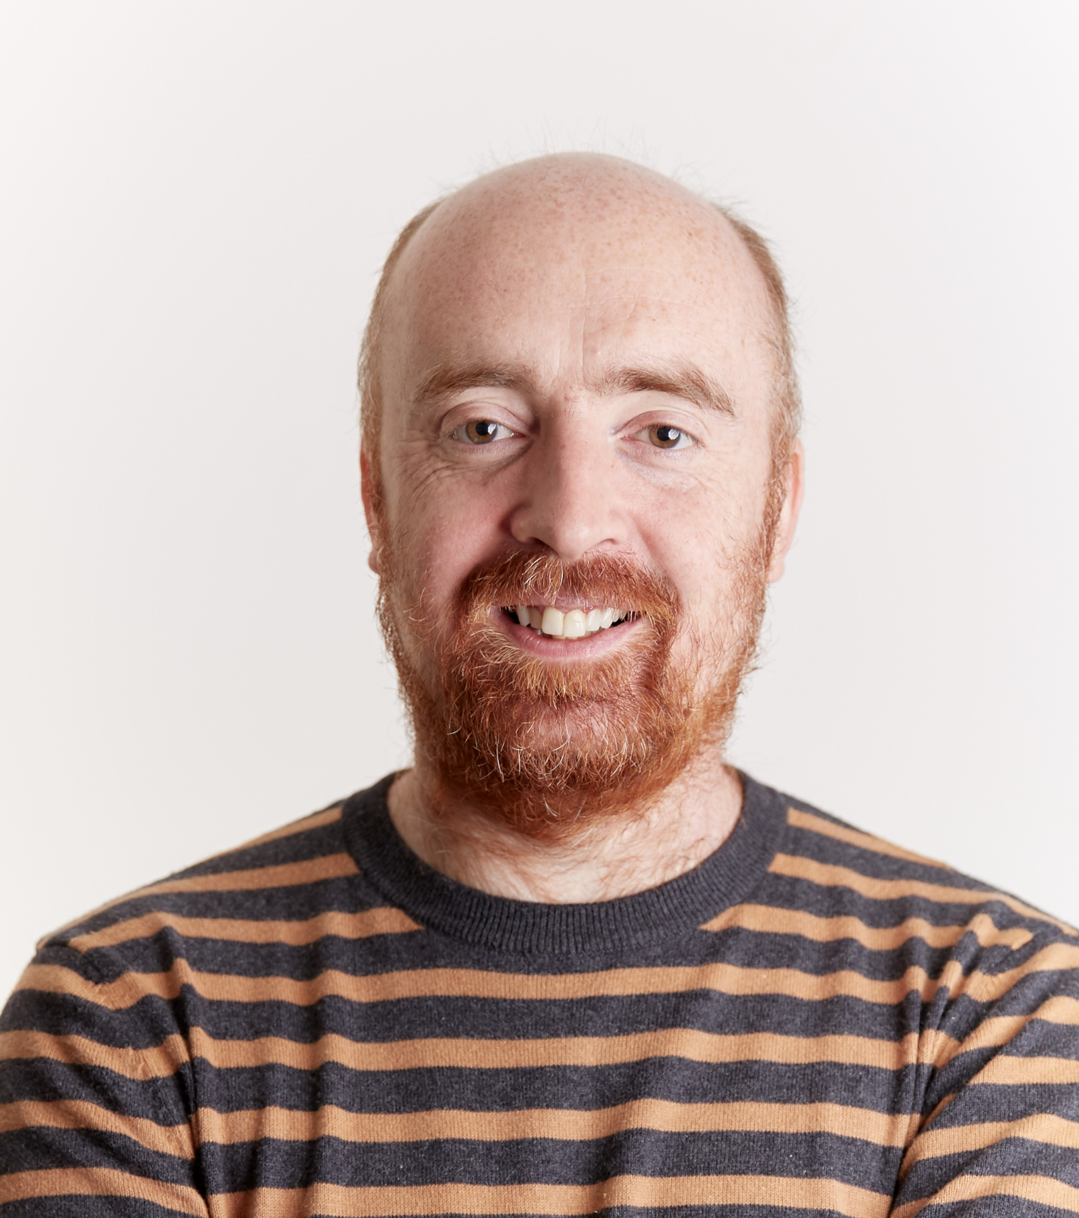
The first CVPR tutorial on
Neural Fields in Computer Vision
Full Day, June 20th, CVPR 2022 (New Orleans)
Invited Speakers
Zongyi Li
Caltech
Ellen Zhong
MIT
Alex Evans
Nvidia

